Slide 1
IET 419
Total Quality Improvement
Group Project 3
Department of Industrial and Engineering Technology
Morehead State University
INSTRUCTOR: Ahmad Zargari
Created by: Group A
DATE: November 21, 2010

Slide 3
Vision
Guardian’s vision is to become the global leader in high value coatings on plastics… to ensure that Guardian’s innovations are practical, that their coatings are durable, and that their methods are efficient… to keep research facilities close to manufacturing operations. That way, science and production form teams that anticipate challenges and develop effective solutions.

Slide 4
PURSUIT OF SUCCESS
While Guardian has always prided itself on winning through creative, aggressive competition, their active pursuit of success must always be combined with honesty and integrity. Guardian groups are expected to deal honestly and ethically with customers, suppliers, governmental bodies, the public, and each other.
The Guardian Way is to entrust people with responsibility for which they can be held accountable. Every Guardian employee is responsible, and will be accountable, for upholding Guardian’s standards.

Slide 5
Quality Pledge
1. Total customer satisfaction.
2. Strong, profitable partnerships with customers and suppliers.
3. Open communication among all employees.
4. A quality system which documents how each entity of the corporation conducts its business and meets its objectives.
5. Employee involvement in the successful implementation of the quality system.
6. Continuous improvement of products and services.

Slide 6
Guardians measures of quality
Clean work environment
Team-oriented employee values
Customer satisfaction
World-class quality with leading edge technology

Slide 7
IN’S AND OUT’S
• Plastic beads
• Brackets
• Wiring harness
• Connectors
• Grilles
• Body panels
• Spoilers
• Consoles
High quality, low cost auto products

Slide 8
Continuous Improvement
Continuous improvement process is an ongoing effort to improve products, services, or processes. These efforts can seek improvement over time or improvement all at once. Delivery processes are constantly evaluated and improved in the satisfaction of their efficiency, effectiveness and flexibility.

Slide 9
A Coordinate Measuring Machine is a device for measuring the physical geometrical characteristics of an object. Measurements are defined by a probe attached to the third moving axis of this machine. A (CMM) is also a device used in manufacturing and assembly processes to test a part or assembly against the design intent. By precisely recording the X, Y, and Z coordinates of the target, points are generated which can then be analyzed via regression algorithms for the construction of features
They are often used for:
• Dimensional measurement
• Profile measurement
• Angularity or orientation measurement
• Depth mapping
• Digitizing or imaging
• Shaft measurement

Slide 10
Coordinate Measuring Machine

Slide 12
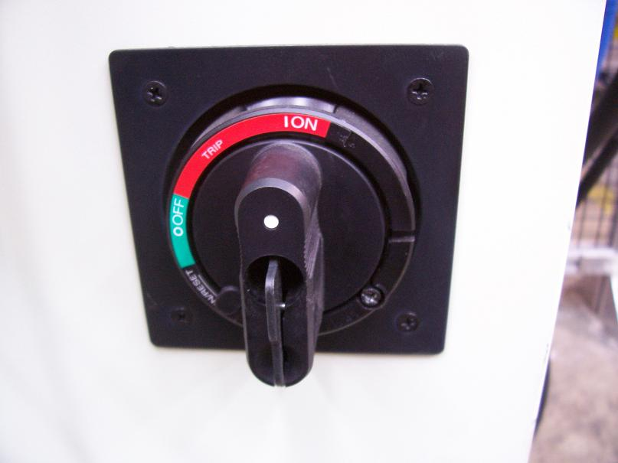
6.6.2- Picture # 2- Proper unlocked position.

Slide 13
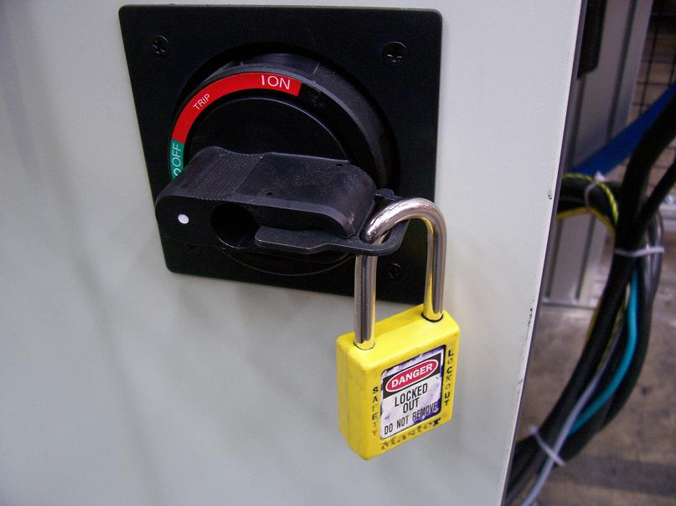
6.6 Special Conditions 6.6.1- Picture # 1-Proper Lock Out Demonstration.

Slide 14
Process/Inspection Flowchart Non-conforming materials & Reject Tickets

Slide 17
Will they stay competitive? Why?
SRG Global the parent company of Guardian Glass's Kentucky facility manufactures plastic products for the automotive industry will remain competitive. They are leaders in the automotive plastics industry. They continuously are investing in new technologies, their customers, and their employees. By investing in new technologies they can remain competitive in the global market and also produce new cutting edge products that will help make better automobiles. Guardian invests in it's customers, it's customers are the automobile manufacturers. The automobile manufacturers are satisfied if the product that they sell, which contains products made by Guardian, satisfies the consumer. Customer satisfaction in the automotive industry creates repeat customers. Guardian will continue to remain competitive because they invest in their employees by fair wages, safe working conditions, and continued training. By investing in your employees your employees will do their best for the organization which translates into on time production and quality products. Guardian focuses on staying with current technologies, customer satisfaction, and employee welfare. This is why they are competitive and why they will remain to do so.

Slide 18
What are their strengths and weaknesses?
Strengths of the company are:
Strong, profitable partnerships with customers and suppliers
Open communication among all employees.
A quality system which documents how each entity of the corporation conducts its business and meets its objectives.
Continuous improvement of products and services.
Some Weaknesses are:
Doesn’t deal with the smaller businesses.
Too much employee responsibility.
Lots of wasted material.

Slide 19
What course of action would you recommend to make them more competitive?
To make Guardian/SRG Global a bigger competitor on the market, they first need to be able to market their products better. Though they are a specialty company specifically for the automotive industry, expanding to a privatized market or offering a wider variety of product could greatly increase the size of the company and make it grow.
Specializing in a specific field makes you the only company producing the part or parts, but expanding into other markets can boost the development of the company. If SRG Global would use the PDSA cycle to learn about new methods, the opportunities could be endless.
As being a plastic injection molding plant, automotive parts are not the only thing they could be limited to. Almost everything manufactured now has plastic in its dimensions.

